Slide 1


Bernardo Melo
02/20/2025

Slide 2

Outline
Executive Summary
Introduction
Methodology
Results
Conclusion
Appendix

Slide 3
Executive Summary
• Summary of methodologies
Data Collection through API
Data Collection with Web Scraping
Data Wrangling
Exploratory Data Analysis with SQL
Exploratory Data Analysis with Data Visualization
Interactive Visual Analytics with Folium
Machine Learning Prediction
• Summary of all results
Exploratory Data Analysis result
Interactive analytics in screenshots
Predictive Analytics result

Slide 4
Introduction
Project background and context
SpaceX advertises Falcon 9 rocket launches on its website, with a cost of 62 million dollars; other providers cost upward of 165 million dollars each, much of the savings is because SpaceX can reuse the first stage. Therefore if we can determine if the first stage will land, we can determine the cost of a launch.
Problems you want to find answers
Can we predict whether the first stage will land successfully?
Can we use this info to define a launch cost?
What factors influence the successful landing of the Falcon 9 first stage?

Slide 5

Section 1

Slide 6
Methodology
Executive Summary
Data collection methodology:
Data was collected through SpaceX API and Wikipedia scrapping.
Perform data wrangling
One hot encode applied on categorical features.
Perform exploratory data analysis (EDA) using visualization and SQL
Perform interactive visual analytics using Folium and Plotly Dash
Perform predictive analysis using classification models
How to build, tune, evaluate classification models

Slide 7
Data Collection
Data was collected via SpaceX open API and Wikipedia scrapping;
Data was decoded to a JSON object to facilitate handling thru pandas;
Converted data to a DataFrame of pandas;
All the necessary cleaning and wrangling;

Slide 8
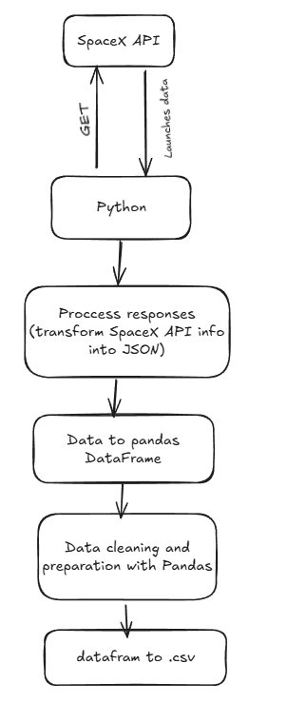
Data Collection – SpaceX API
Used python requests to make GET request and get data from SpaceX API, prepared and cleaned, as well as saving it to a .csv with pandas.
https://github.com/bernardomelo/DataScienceCapstone-IBM/blob/main/jupyter-labs-spacex-data-collection-api.ipynb

Slide 9
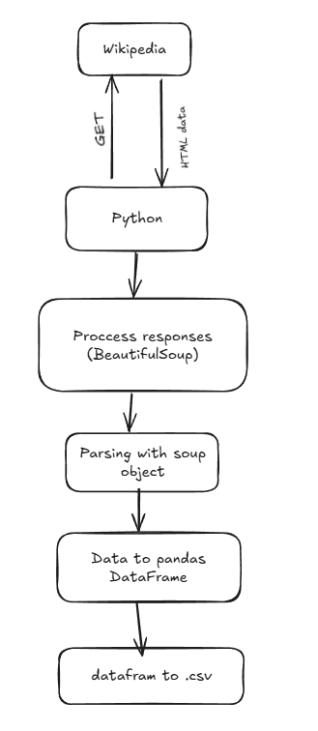
Data Collection - Scraping
Used requests to make a get request and extract HTML from the response;
BeautifulSoup to parse HTML;
Pandas to convert into df and then .csv.
https://github.com/bernardomelo/DataScienceCapstone-IBM/blob/main/jupyter-labs-webscraping.ipynb

Slide 10
Data Wrangling
Performed exploratory data analysis and determined the training labels;
Calculated the number of launches at each site, and the number and occurrence of each orbits;
Created landing outcome label from outcome column and exported the results to csv.
https://github.com/bernardomelo/DataScienceCapstone-IBM/blob/main/labs-jupyter-spacex-Data%20wrangling.ipynb

Slide 11
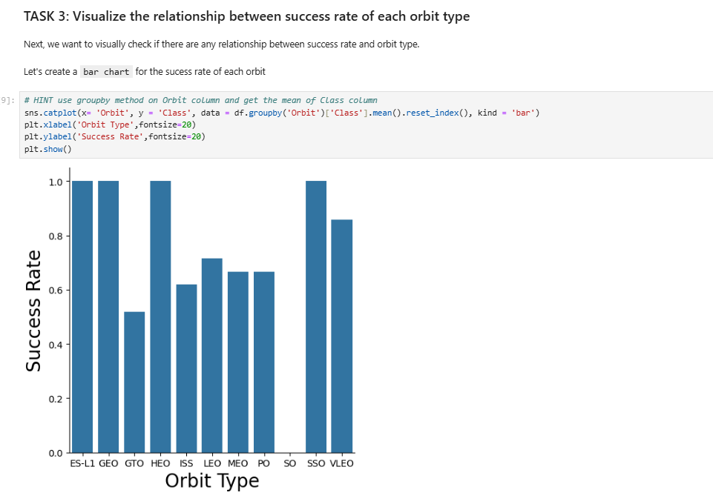
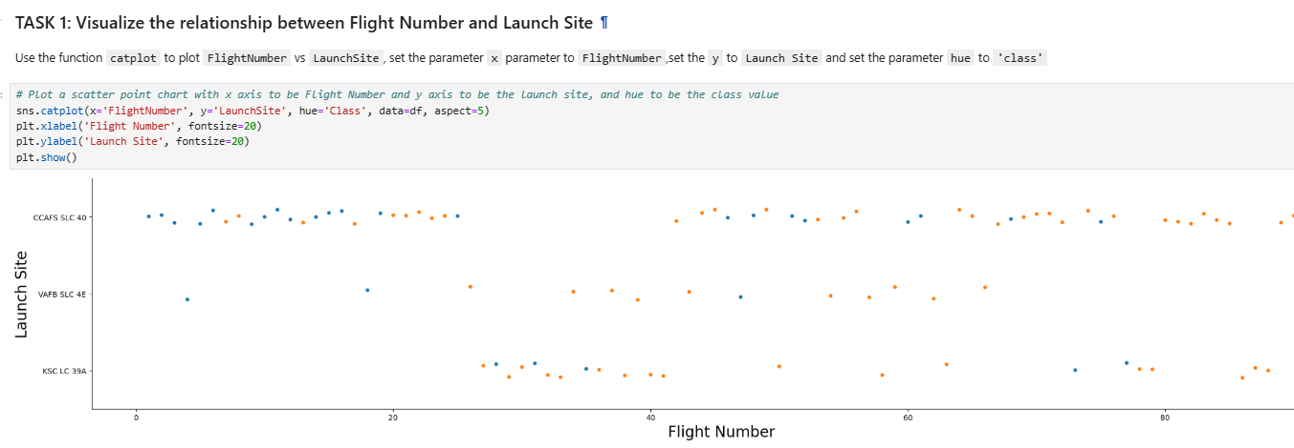
EDA with Data Visualization
Mainly Scatter Plot’s used to determine relationship between features. Bar chart was also used.
https://github.com/bernardomelo/DataScienceCapstone-IBM/blob/main/edadataviz.ipynb

Slide 12
EDA with SQL
We applied EDA with SQL to get insight from the data. These were the queries wrote:
Names of unique launch sites in the space mission;
Total payload mass carried by boosters launched by NASA (CRS);
Average payload mass carried by booster version F9 v1.1;
Total number of successful and failure mission outcomes;
Failed landing outcomes in drone ship, their booster version and launch site names;
https://github.com/bernardomelo/DataScienceCapstone-IBM/blob/main/jupyter-labs-eda-sql-coursera_sqllite.ipynb

Slide 13
Build an Interactive Map with Folium
Marked all launch sites, added map objects such as markers, circles, lines to mark the success or failure of launches for each site;
Assigned the feature launch outcomes o class 0 and 1 i.e., 0 for failure, and 1 for success;
Using the color-labeled marker clusters, identified which launch sites have relatively high success rate;
Calculated the distances between a launch site to its proximities. Some answered questions:
Are launch sites near railways, highways and coastlines?
Do launch sites keep certain distance away from cities:
https://github.com/bernardomelo/DataScienceCapstone-IBM/blob/main/lab_jupyter_launch_site_location.ipynb

Slide 14
Build a Dashboard with Plotly Dash
Plotted pie charts showing total launches on certain launch sites;
Scatter graph with relationship between Outcome and Payload for different booster versions;
https://github.com/bernardomelo/DataScienceCapstone-IBM/blob/main/spacex_app.py

Slide 15
Predictive Analysis (Classification)
Loaded data using pandas and numpy, transformed it and split train/test;
Built some models (logreg, SVM, decision tree, KNN);
Used GridSearch to tune different hyperparameters;
Used Jaccard Score, F1 and accuracy as metrics to define the better model
Found best model to use.
https://github.com/bernardomelo/DataScienceCapstone-IBM/blob/main/SpaceX_Machine%20Learning%20Prediction_Part_5.ipynb

Slide 16
Results
Exploratory data analysis results
Interactive analytics demo in screenshots
Predictive analysis results

Slide 17

Section 2

Slide 18
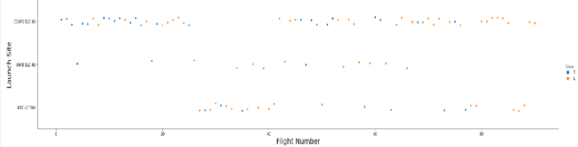
Flight Number vs. Launch Site
Plot shows that the larger the flight amount at certain site, the greater the success rate there.

Slide 19
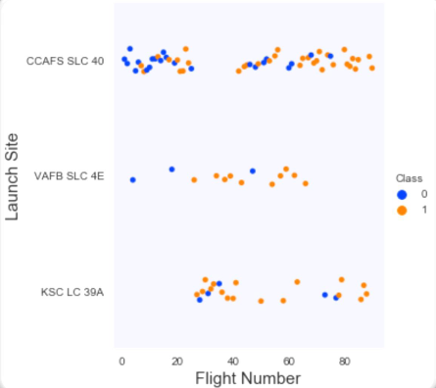
Payload vs. Launch Site
The scatter plot of Launch Site vs. Flight Number shows that:
Number of flights increases, the rate of success at a launch site increases;
No early flights launched from KSC LC 39A, explains why launches from this site are more successful;
Above a flight number of around 30, there are significantly more successful landings (Class = 1).

Slide 20
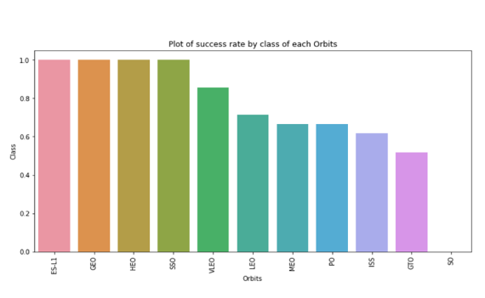
Success Rate vs. Orbit Type

Slide 21
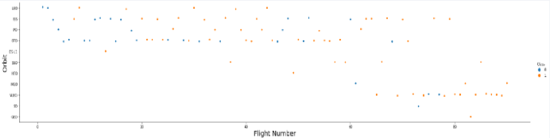
Flight Number vs. Orbit Type
Plot shows that in the LEO orbit, success is related to the number of flights, but in GTO orbit, there aren't any relationships between flight number and the orbit.

Slide 22
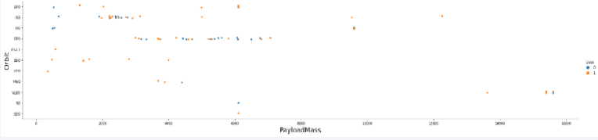
Payload vs. Orbit Type
Plot show us that PO, LEO and ISS are more successful with heavy payloads.

Slide 23
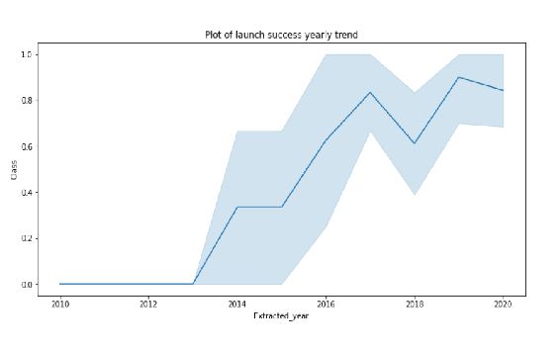
Launch Success Yearly Trend
Plot shows us a steady increase rate from 2013 to 2020.

Slide 24
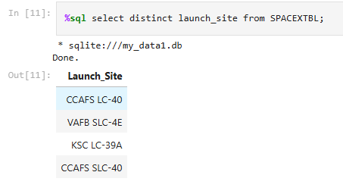
All Launch Site Names
Simple select query with DISTINCT to show unique launch site names.

Slide 25
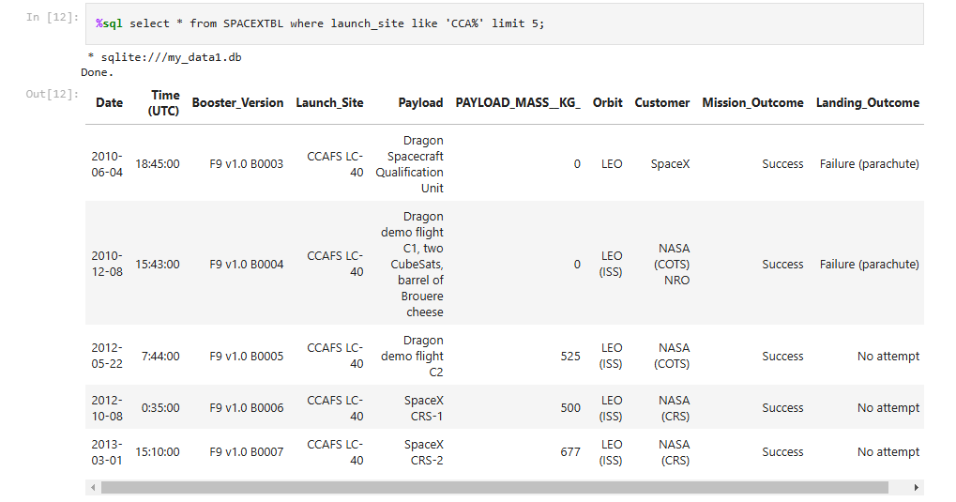
Launch Site Names Begin with 'CCA'
Simple select query with WHERE clause in launch_site column with LIKE clause searching for ‘CAA%’ string beginnings, with LIMIT to 5, to only print the first 5 rows.

Slide 26
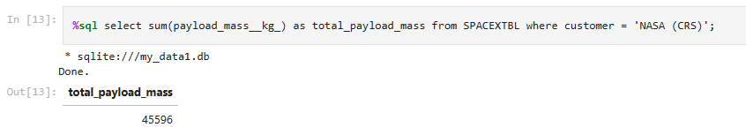
Total Payload Mass
Calculates the total payload mass for NASA (CRS) missions, adds up all payload masses and filters records to include only launches for NASA (CRS).

Slide 27
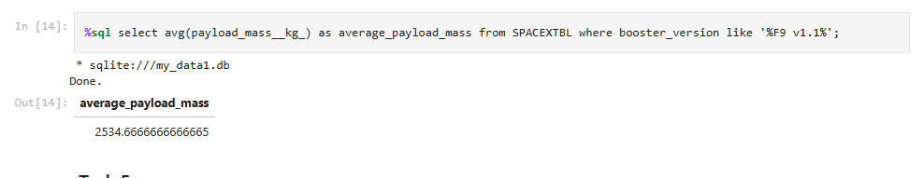
Average Payload Mass by F9 v1.1
Calculates the total payload mass for NASA (CRS) missions, adds up all payload masses and filters records with WHERE clause to look for F9 v1.1.

Slide 28
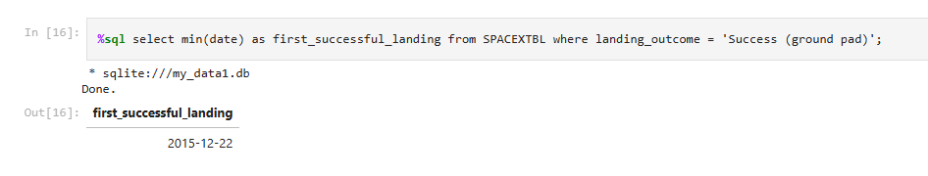
First Successful Ground Landing Date
Selects the minimal date on first_succesful_landing column with clause WHERE in landing_outcome being “Success (ground pad)”.

Slide 29
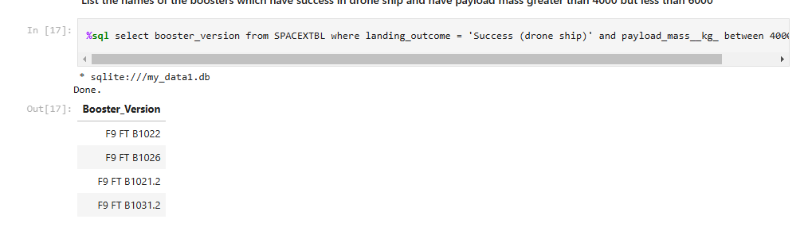
Successful Drone Ship Landing with Payload between 4000 and 6000
Selects the booster_version column with clause WHERE in landing_outcome being “Success (ground pad)” and payload_mass_kg in the asked range.

Slide 30
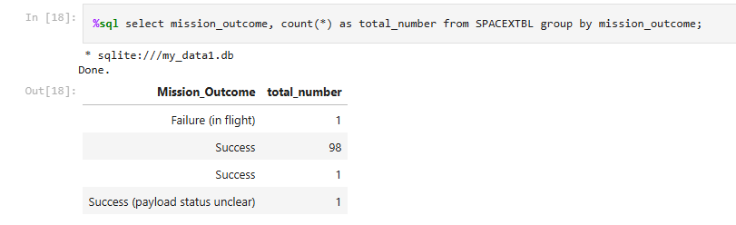
Total Number of Successful and Failure Mission Outcomes
Counts the number of missions for each outcome category.

Slide 31
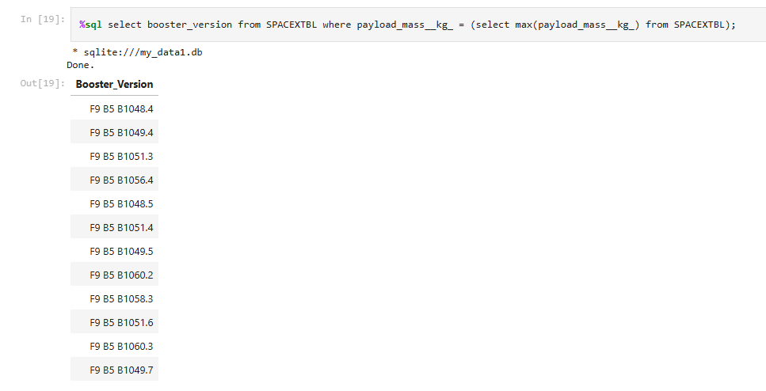
Boosters Carried Maximum Payload
Determined the booster that have carried the maximum payload using a subquery in the WHERE clause and the MAX() function.

Slide 32
2015 Launch Records
List the failed landing_outcomes in drone ship, their booster versions, and launch site names for in year 2015
Present your query result with a short explanation here

Slide 33
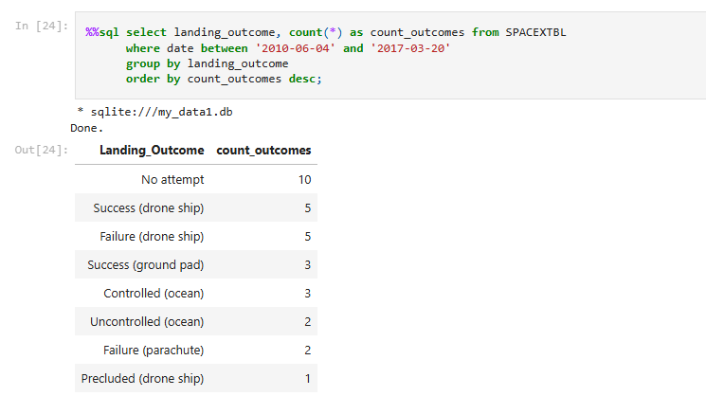
Rank Landing Outcomes Between 2010-06-04 and 2017-03-20
We selected Landing outcomes and the COUNT of landing outcomes from the data and used the WHERE clause to filter for landing outcomes BETWEEN 2010-06-04 to 2010-03-20. Applied the GROUP BY clause to group the landing outcomes and the ORDER BY clause to order the grouped landing outcome in descending order.

Slide 34

Section 3

Slide 35
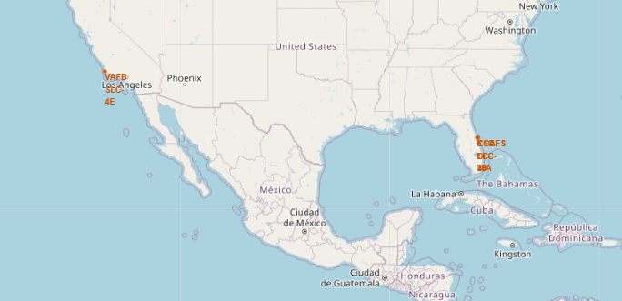
All launch sites global map marker
From the picture, we can see that basically all launch sites are in US coastal places.

Slide 36
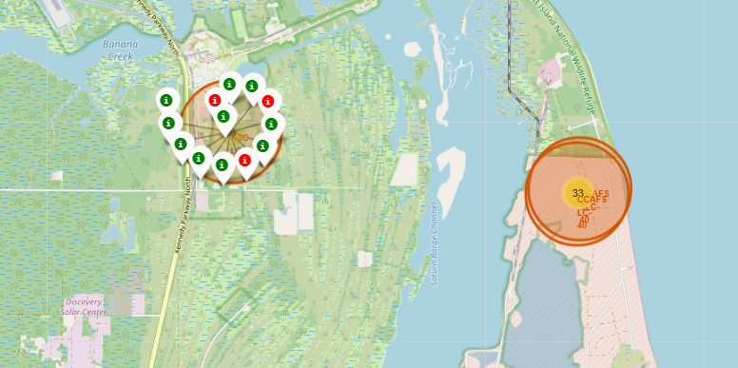
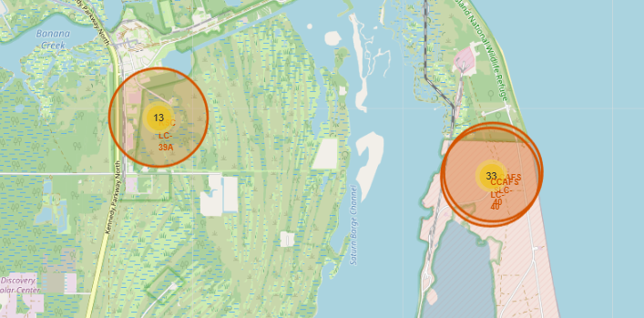
Markers showing launch sites with color labels
Green markers are successes, red failures;
More successes in general than fails.

Slide 37
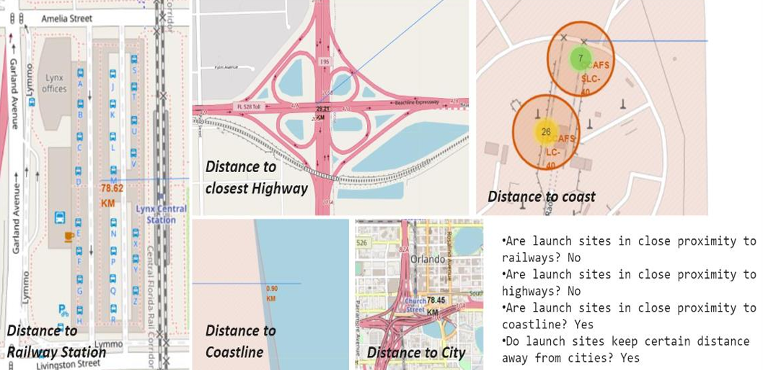
Distance from launch sites to landmarks

Slide 38

Section 4

Slide 39
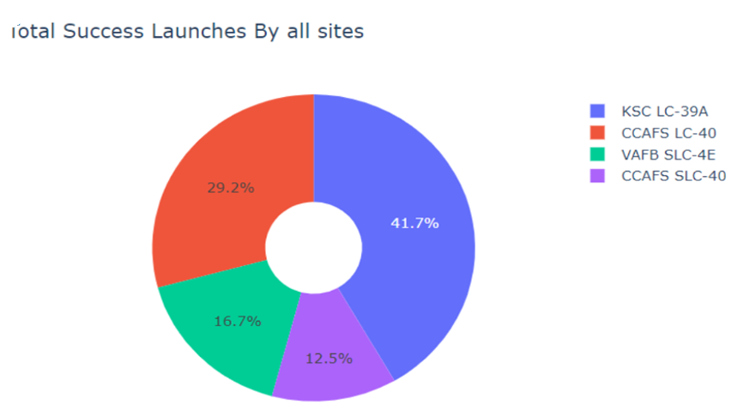
Success Launches by sites
KSC LC-39A seem to have the most successes.

Slide 40
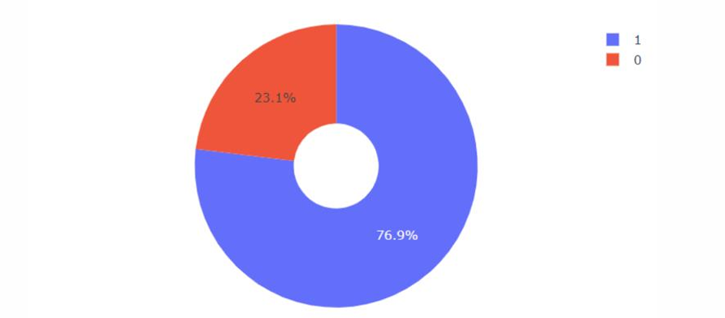
Success/Failure ratio
76.9% Success rate
23.1% Failure rate

Slide 41
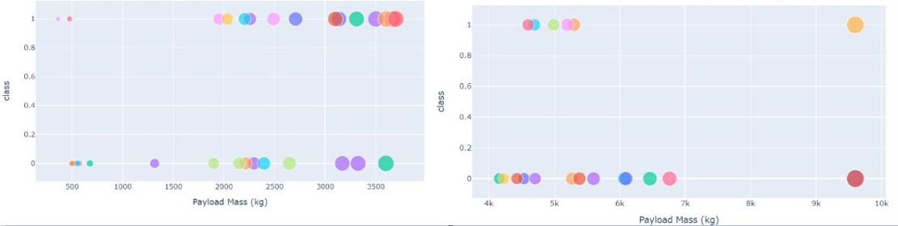
Scatter plot of Payload vs Launch Outcome for all sites
Low weighted payload
Heavy weighted payload

Slide 42

Section 5

Slide 43
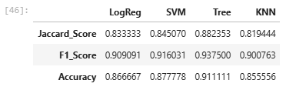
Classification Accuracy

Slide 44
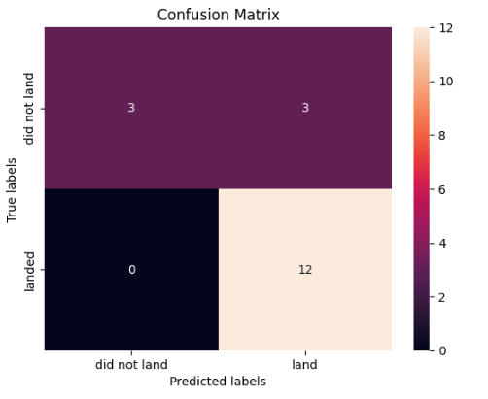
Confusion Matrix
The confusion matrix for the decision tree classifier shows that the classifier can distinguish between the different classes. The major problem is the false positives .i.e., unsuccessful landing marked as successful landing by the classifier.

Slide 45
Conclusions
• The larger the flight amount at a launch site, the greater the success rate at a launch site.
• Launch success rate started to increase in 2013 till 2020.
• Orbits ES-L1, GEO, HEO, SSO, VLEO had the most success rate.
• KSC LC-39A had the most successful launches of any sites.
• The Decision tree classifier is the best machine learning algorithm for this task

Slide 46


